Slide 1
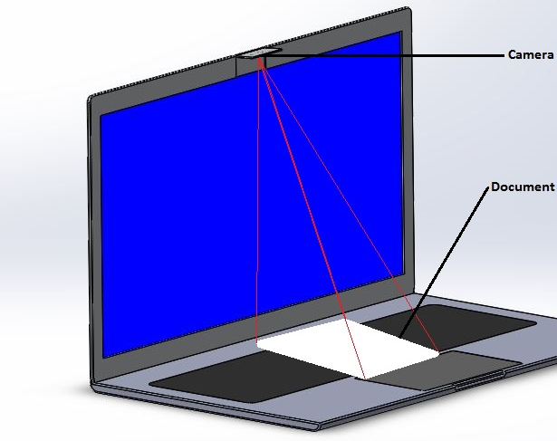
BUILT-IN SCANNER IN THE LAPTOP
Batch: 17CD021
170070177 Hemanth. S
170070151 Ameer Khan
170070248 Sai Kumar. D

Slide 2

ABSTRACT
Turning Hard Document into Soft Document and sharing has become a hard and time-consuming task nowadays. By implementing or adapting this design in upcoming laptops users can on-the-go scan documents using their laptops and share or save them in laptop itself. No extra accessory is needed the same camera can be used for attending video conferences as well-as for scanning documents. And user can also feel secure about their privacy because while camera is not in use it will automatically be in closed position.

Slide 3


NECESSITY
Many people are scanning documents using cell phones and transferring it to computers and sharing. By this project we can scan the document without use of any scanner or mobile phone. Completely on the go we can scan and share them. This project maybe very helpful for students, employees, etc .

Slide 4
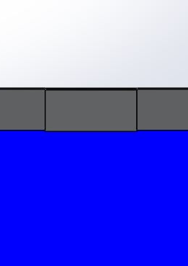
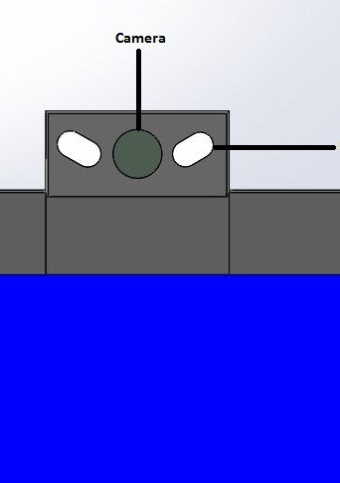
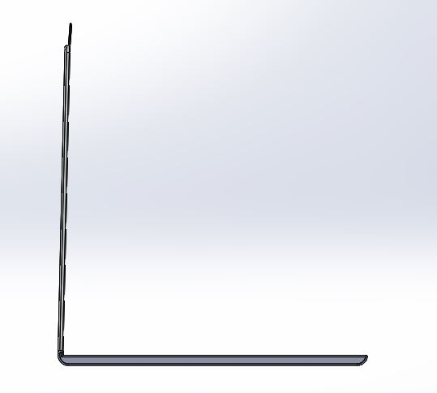
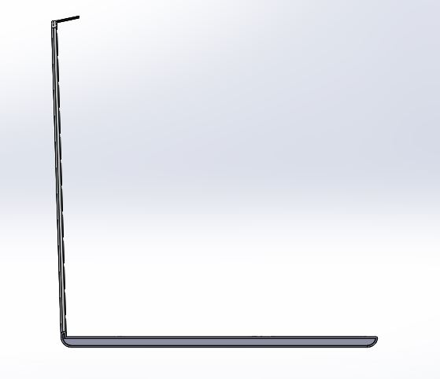
DESIGN

Slide 5
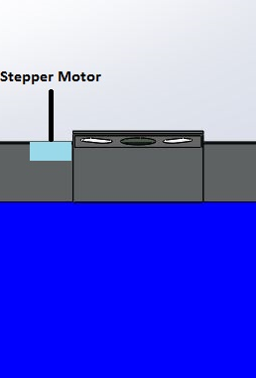
METHODOLOGY
There should be a Stepper motor fixed to the camera.
For our different needs the camera will automatically adjusts its angle. Like,
When user is not using camera, it will be in closed position where a user can feel secure about his/her privacy.
When a user need to make a videocall the camera will be fully opened.
When a user need to scan a document, the camera will tilt down towards document.

Slide 6

MECHANISM VIDEO

Slide 7
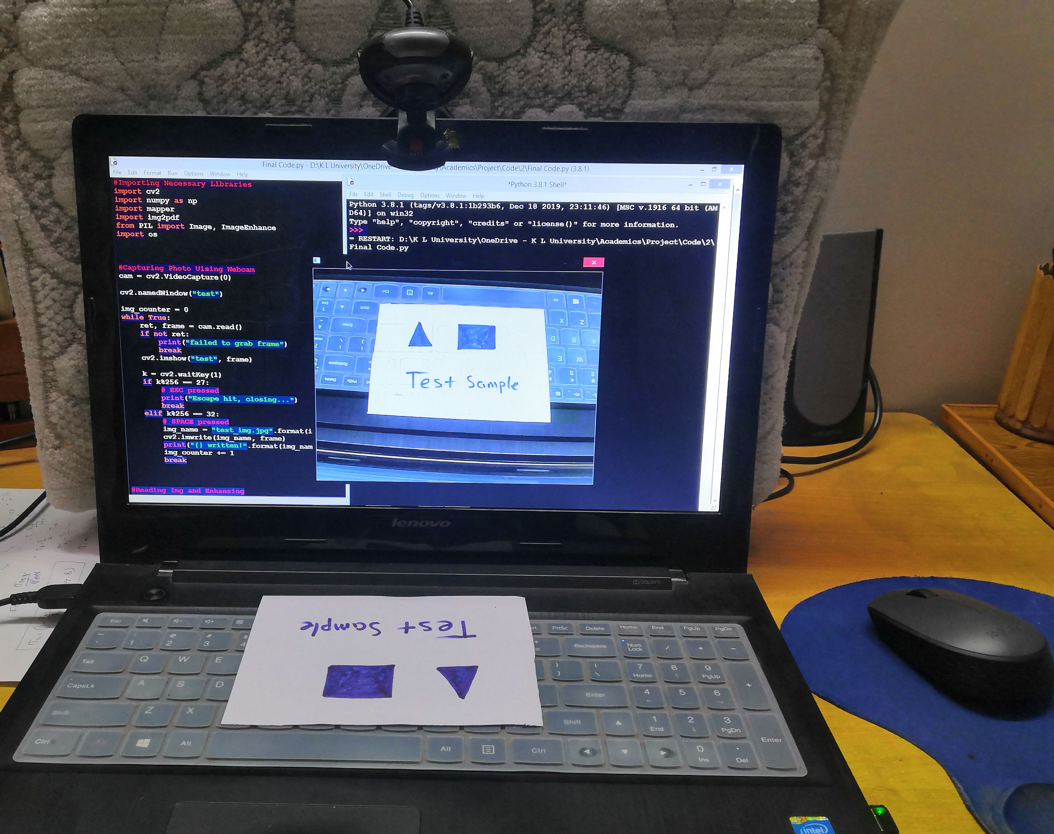
WORKING

Slide 8

Python Libraries
1. OpenCV: It is a library used for real-time computer vision.
2. NumPy: It is a library used for adding large and multidimensional arrays and matrices.
3. Mapper: It is a library used for analysis and visualization of data.
4. PIL (Pillow): It is an Imaging library used for manipulating and saving many image formats.
5. Img2Pdf: It is a library used for converting images to pdf
6. OS: It is a library provides functions for interacting with the operating system.

Slide 9
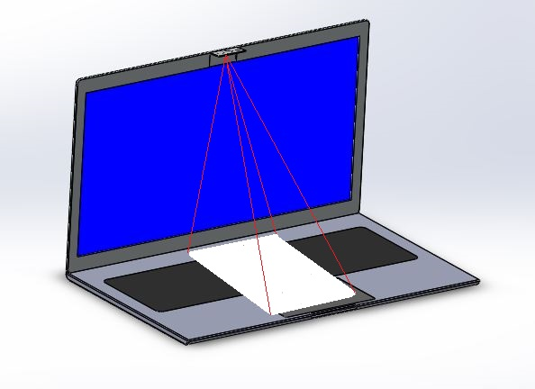
PROCESS OF SCANNING DOCUMENT
Step 1: Scan or snap a photo and save.
Step 2: Apply grayscale filter to original image cut the edges of the image.
Step 3: Save the image.
Step4: Enhance by adjusting Brightness and Sharpness of the image.
Step 5: Save the enhanced image as jpg file.
Step 6: Convert the saved jpg file to pdf and save the output.

Slide 10
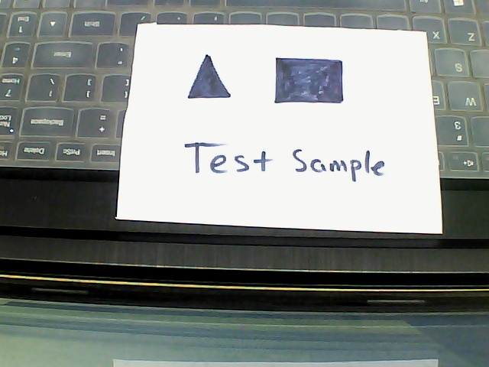
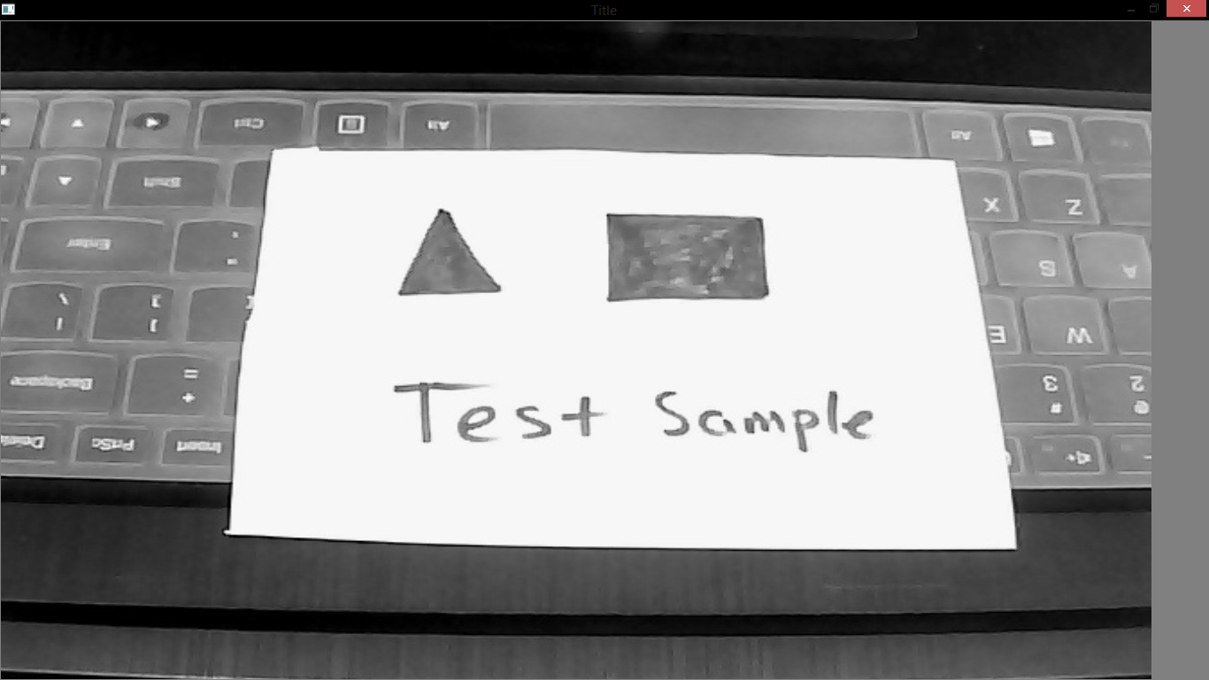
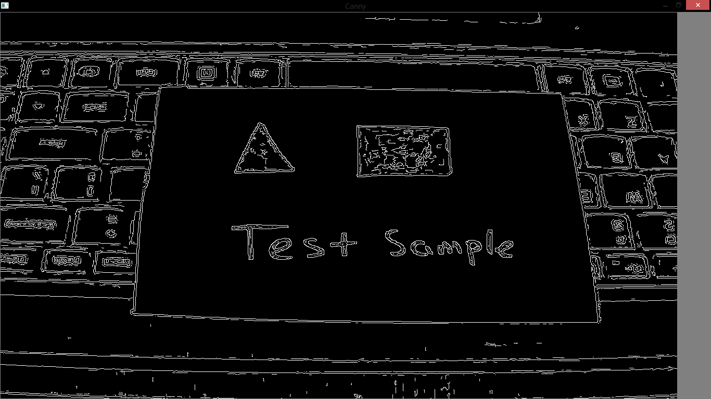
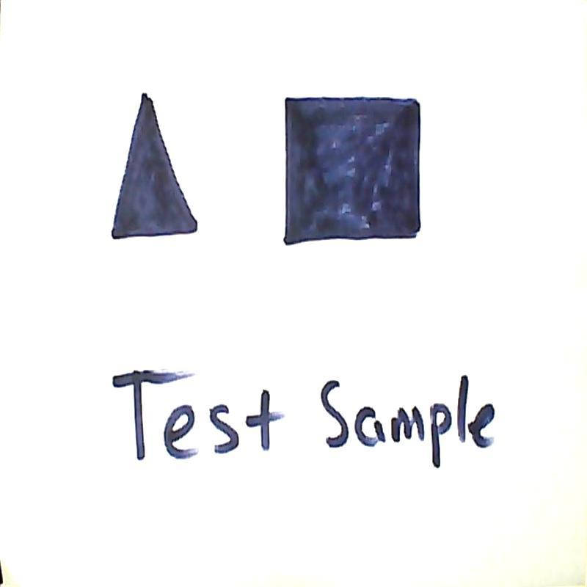
RESULTS
1. Original Image
2. Grayscale Converted
3. Canny Edge Detection
4. Final Output: With edges
Mapped, Improved Brightness
and Sharpness

Slide 11
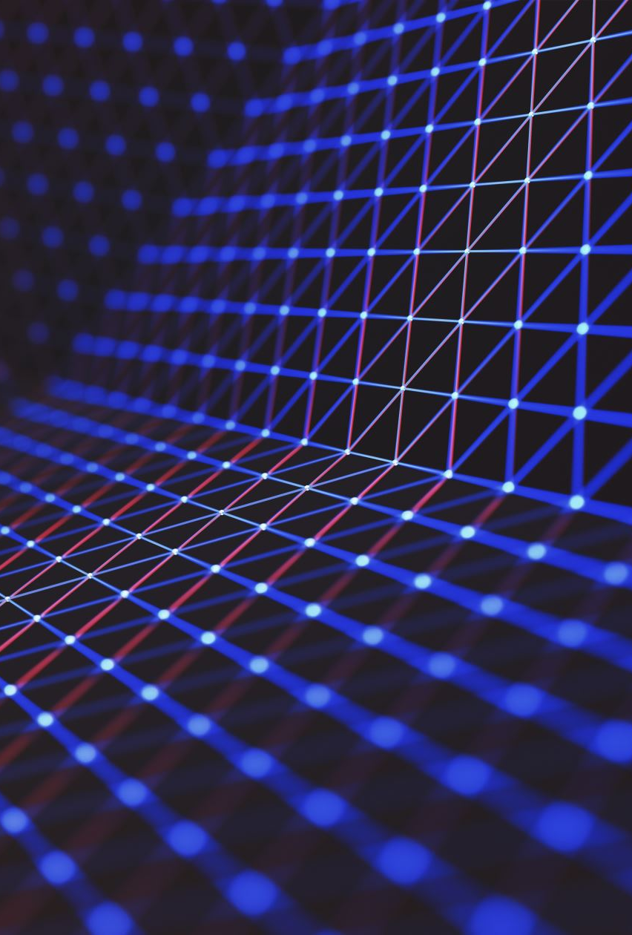
IS THIS DESIGN USED BEFORE ?
No one used this design before but there were similar projects in which they used a separate component to scan the documents which cannot be used everywhere.
Therefore, We are applying for a Patent.

Slide 12

THANK YOU

